Slide 1
ONLINE QUIZ APPLICATION
Review-1
Under the guidance of
Mr. Shankar Narayan
Team-V32

Slide 2
Agenda
Introduction​
Primary goals
​Explanation
Screenshots
​Summary

Slide 3
Roles and responsibilities
Registration No. | Name | Responsibilities
20MIS0180 | Kishor Kumar Parida | Top NavBar in Home page
20MIS0191 | Srija Kancha | User Authentication
20MIS0290 | Varsha G | Questions and Result Page
20MIS0291 | Ritheesh Polepalli | Side NavBar in Home page
20MIS0351 | Rahul.N | Content Inside home page

Slide 4
Introduction
The ‘MCQ Quiz Application’ project will be developed to overcome the time consuming problem of manual system. Apart from that in current system, checking the answer sheets after taking test, waste the examiners time, so this application will check the correct answer and save the examiner time and carry the examination in an effective manner. The users which are use this system don’t need to high computing knowledge and also system will inform them while entering invalid data.

Slide 5
Aim and objective
Able the examiners to punch the MCQ questions online
- Able the users to solve the questions online
- Examiners can manage the information regarding exam
- Correct answers will be evaluated by system (First it should be determining by examiner)
- Users can see their result after submitting the test.

Slide 6


Slide 7


Technologies used
For Frontend
-- React JS
For Backend
-- Node Js, Express Js, MongoDB

Slide 8
React Js
We used react js for the frontend to develop login,signup ,home and result pages.We used class components to design and move the components from parent to child.
Modules Involved:
Login.js
Signup.js
Home.js
Question.js
Result.js

Slide 9
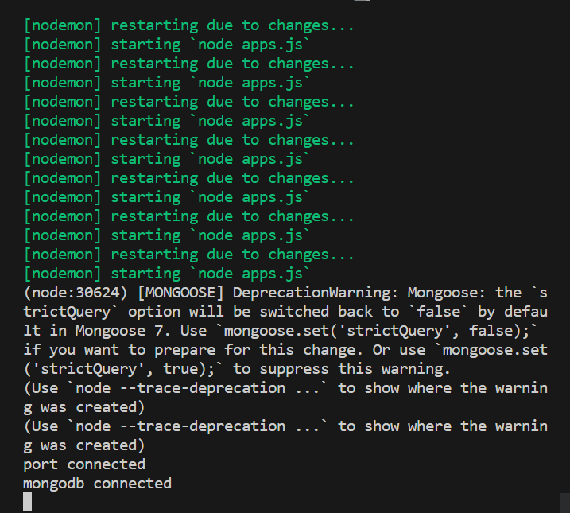
Nodejs,Express js,Mongodb

Slide 10
Explanation
When a new user comes to take their quiz they will have to register with proper credentials only then they will be allowed into the application.
In home page for users they can take their exam view result of all the exams they went through and option for logout would be provided.
For Admin,
In home page admin would be given access to post the question paper and also view the result of all the students who took the quiz.

Slide 11
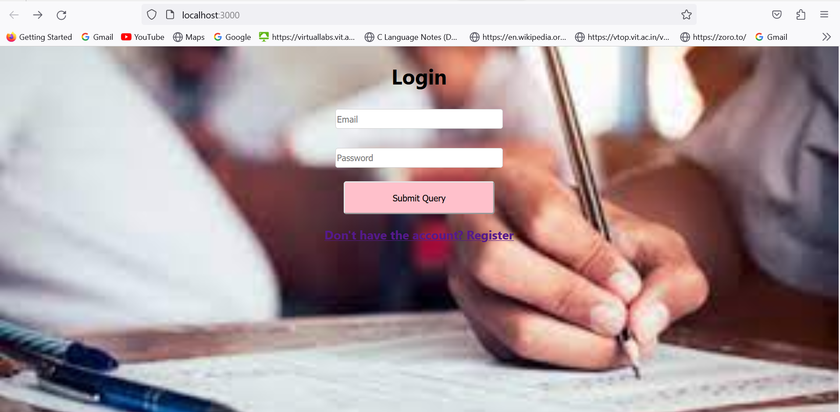
Screenshots
-
Login
Page

Slide 12
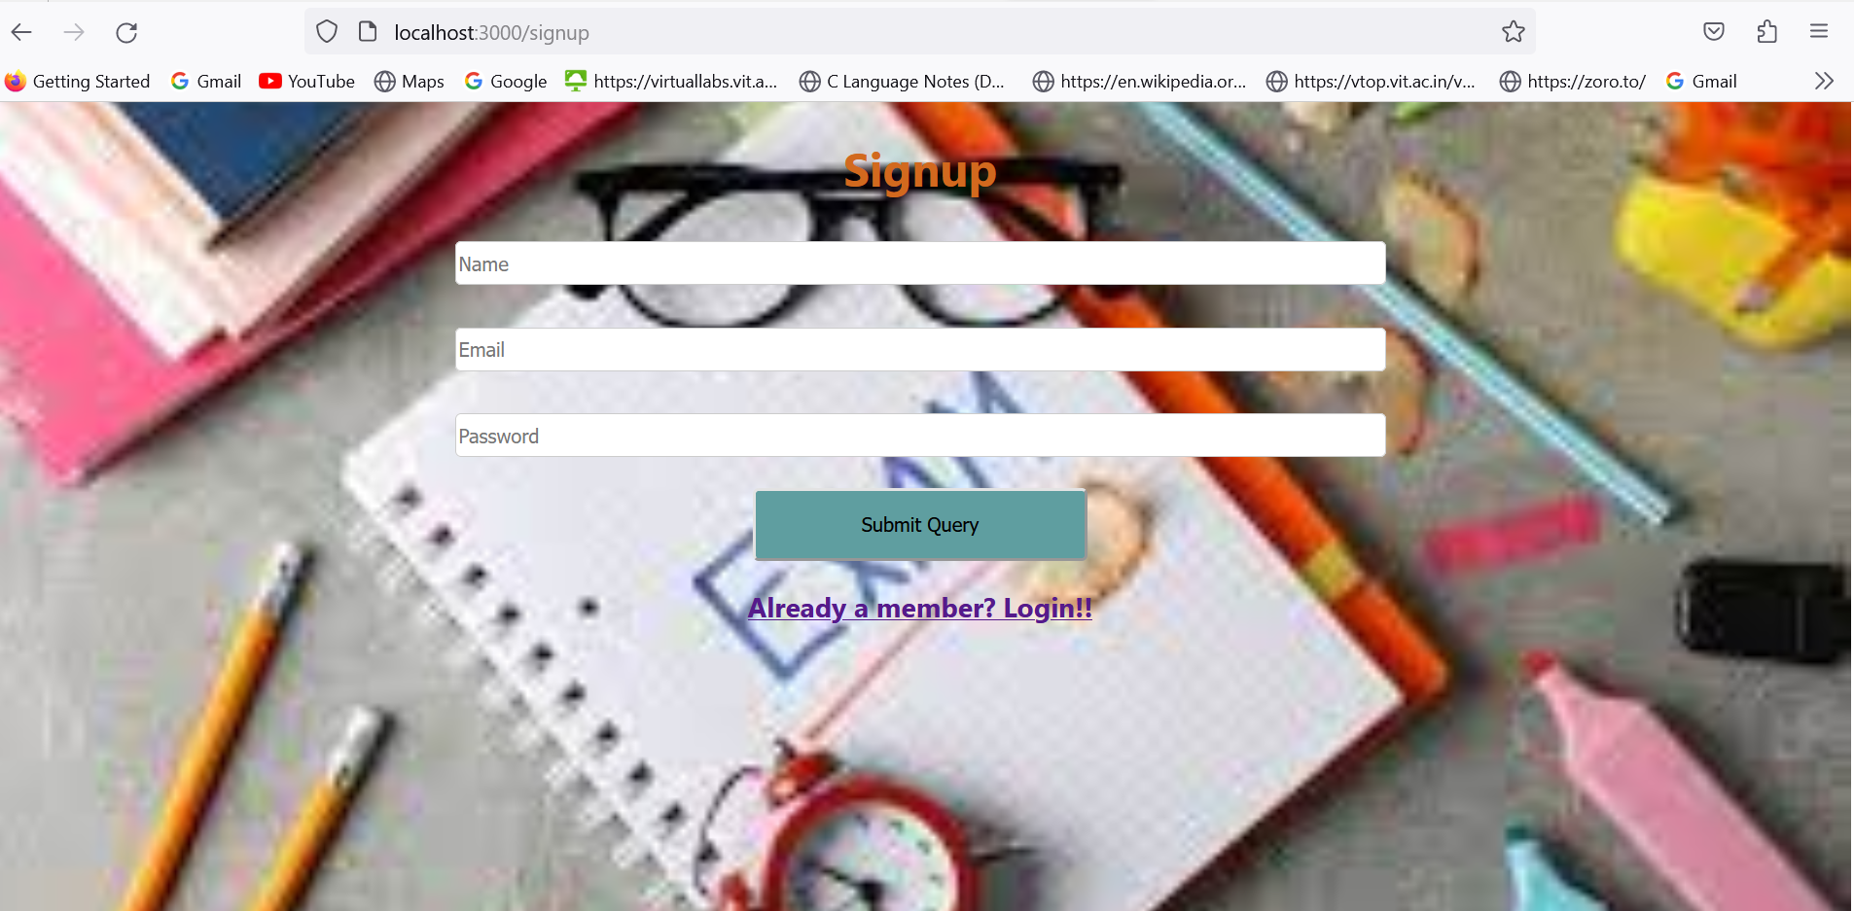
Sign Up

Slide 13
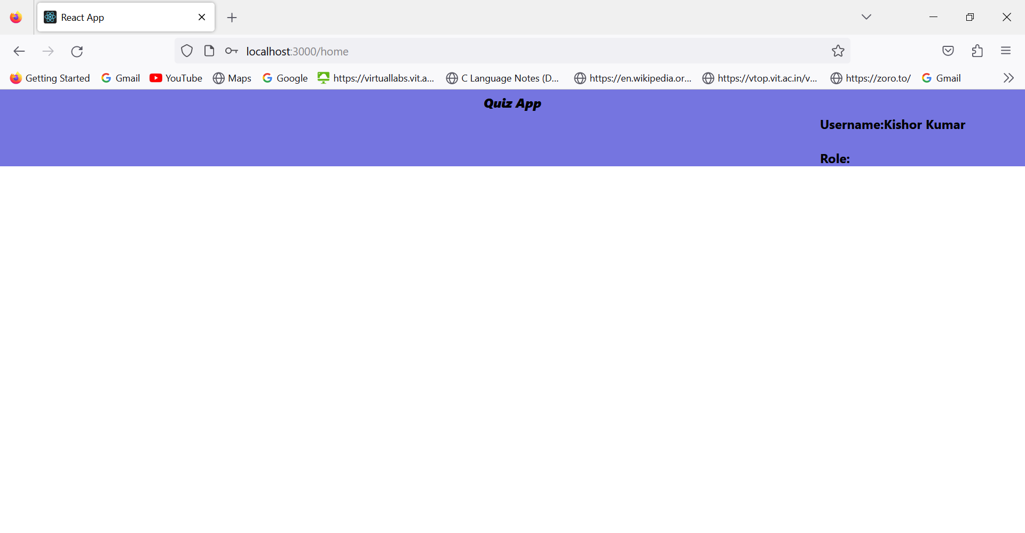
Home Page

Slide 14
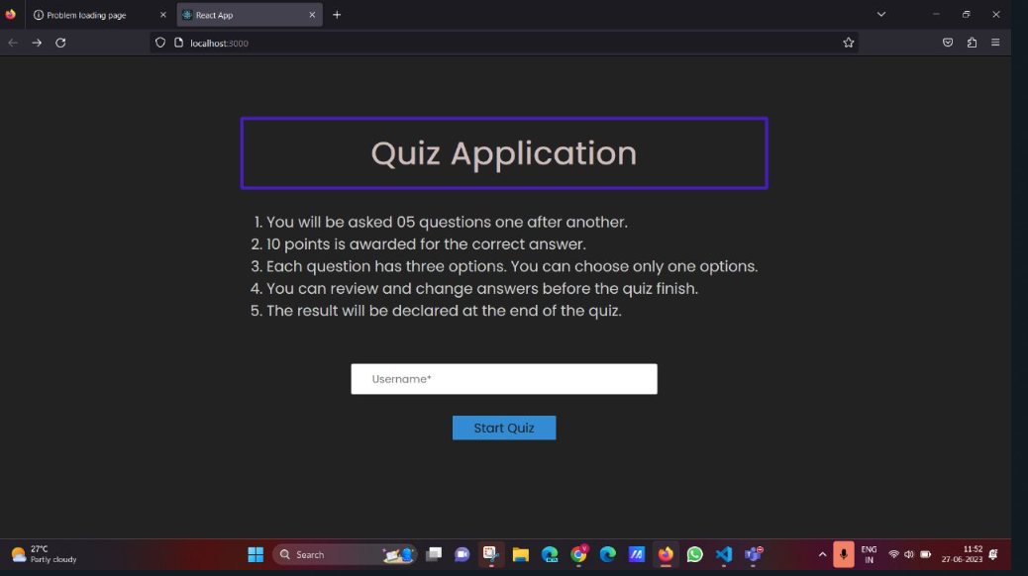
Instructions Page

Slide 15
THANK YOU

